Slide 1
How to protect yourself, your loved ones and vulnerable members of our community: Vaccines, boosters, masks and other new tools
Marion A Kainer Head, Infectious Diseases
Western Health
23 November 2021
Disclaimer
This is a rapidly evolving situation– we are learning more about this virus on a daily basis.

Slide 2
Vaccines
Very safe
Very effective
Not perfect
Reduce in efficacy over time
No infection
Asymptomatic infection
Mild symptoms
Moderate symptoms
Severe disease
Time
Ability to transmit

Slide 3
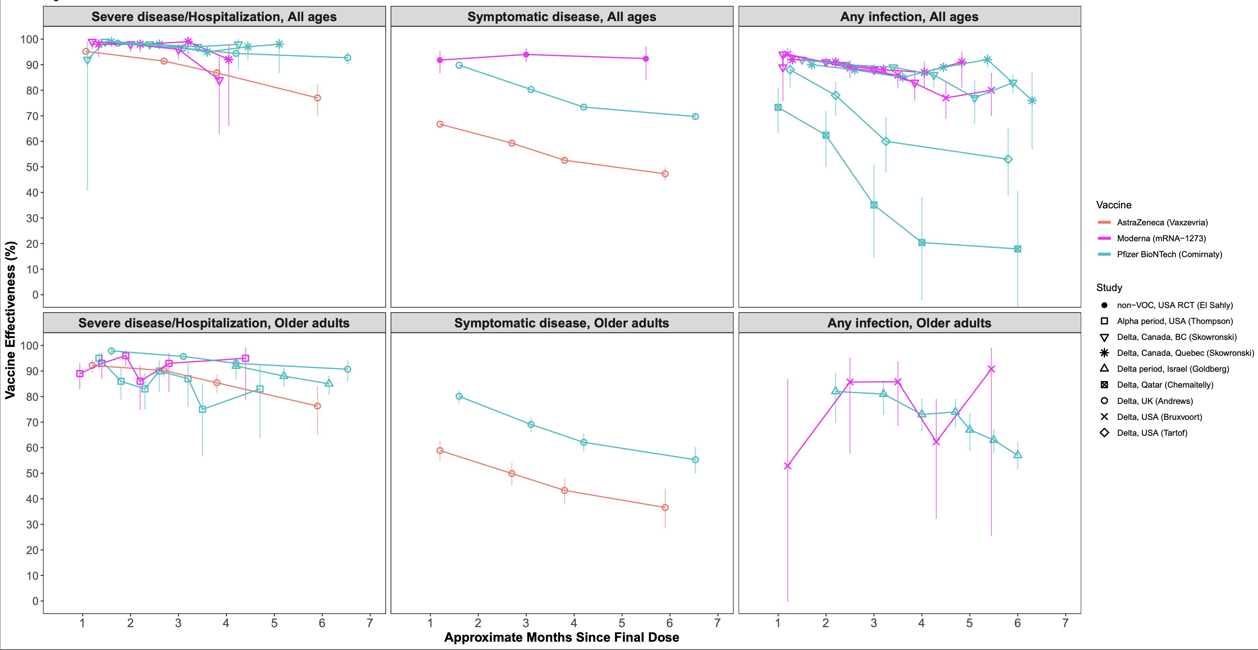
https://papers.ssrn.com/sol3/papers.cfm?abstract_id=3961378

Slide 4
Reduction in Vaccine Efficacy over Time
Occurs faster if older
Shorter time interval between 1st and 2nd dose
Astra Zeneca as 1st and 2nd dose

Slide 6
Booster (ATAGI: 6 months after 2nd dose)
Restores protection
Higher antibody levels than after 2nd dose
Heterologous- (mix and match)
AZ / AZ / Pfizer
Adverse events (note– Pf/Pf/ Moderna)
When does it “kick in”?

Slide 7
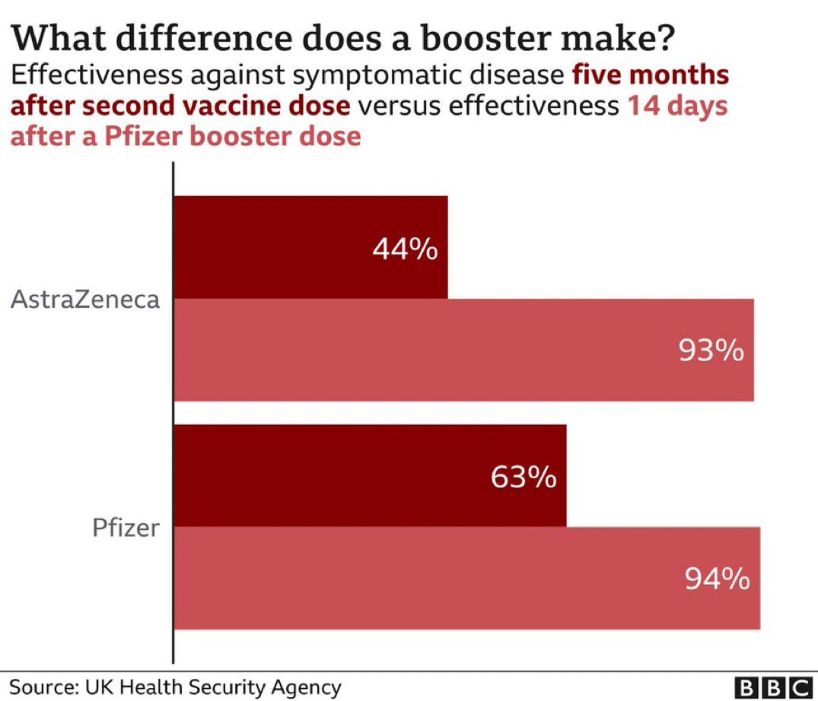

Slide 9
Why Consider a Booster?
Benefit to self
Stay well
Reduce risk of “Long COVID”
Benefit to others
Not transmit to others, especially vulnerable persons
Not transmit to co-workers… so better staffing, better patient care
Reduce transmission in community
Reduce pressure on healthcare system

Slide 10
Examples of Vulnerable Persons
Not yet eligible to be vaccinated (under 12s)/not yet vaccinated
Immunosuppressed
Cancers including blood cancers
Organ transplant
Immunosuppressive medication
Older age
Pregnancy
Underlying conditions, especially if not vaccinated
Disabilities
Obesity
Diabetes
Chronic kidney, liver, lung disease
High blood pressure

Slide 11
Protect vulnerable persons
Vaccination (all vaccinated, booster?)
Wearing mask “Upgrade” your mask
Protect self; protect other (source control)
Rapid Antigen Testing (RAT)
Ventilation (safe indoor air)
Outdoors
Natural ventilation- cross ventilation
Portable HEPA filters
Early testing/ treatment of vulnerable persons

Slide 12
Upgrade your mask
Filtration and fit important
Surgical mask
Tie and tuck
Wear cloth mask over surgical mask
KF94s (Korean mask)
Especially if combine with clip or “ear saver”

Slide 13
Where to wear masks now?
Public transportation
Sharing transportation with persons outside your household (eg car)
Apartment buildings (when leave front door)
Common areas/ stairs / lifts
Inside
Sensitive settings– requirement
Aerosol generating behaviours– shouting, singing, coughing, exercising (beware of noisy venues)
Concerns about poor ventilation

Slide 14
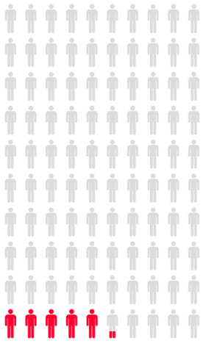
The Outdoors is your “friend”.
Being outside reduces your risk ~20 fold compared to being inside!
Nishiura et al Preprint: https://www.medrxiv.org/content/10.1101/2020.02.28.20029272v2
Images created by Iconarray.com. Risk Science Center and Center for Bioethics and Social Sciences in Medicine, University of Michigan. Accessed 2020-06-24.

Slide 15
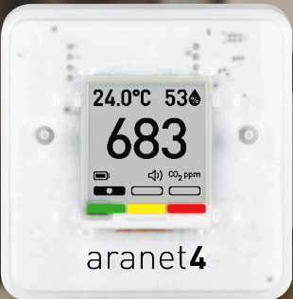
CO₂ Monitor
Indicator of quality of ventilation/ fresh air
Keep <1,000 (ideally <700ppm)
If high– open windows/ doors
Consider HEPA filters
Limitations
Not impacted by HEPA filters
Lots of plants (eg greenhouse)

Slide 16
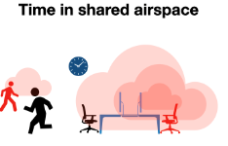
Time in Shared Airspace
Limit meeting times
Limit face-to-face time
Go in /out (don’t linger)
Online delivery services

Slide 17
Portable HEPA Filter/ Air Purifiers
Pure HEPA
Pay attention to clean air delivery rate
Useful adjunct if cannot open windows/ doors
Temperature
Bushfire smoke
https://sgeas.unimelb.edu.au/engage/guide-to-air-cleaner-purchasing

Slide 18
Rapid Antigen Tests (RAT)
Useful adjunct in layered protection strategy
If have symptoms→ PCR test (do NOT rely on negative RAT)
Particularly helpful if perform serially, less than 72 hours apart
Nose (blow nose before)
Saliva (don’t eat/ drink in 10 minute before)
Pay close attention to the narrow TIME INTERVAL to read (eg 15-20 minutes)
If positive→ must get PCR test

Slide 19
Early Diagnosis and New Treatments
Early treatment options now available for immunosuppressed vulnerable persons
New monoclonal antibodies (sotrovimab and romapreve)
Romapreve now available as post exposure prophylaxis!
So– DYI contact tracing is really important!
New antivirals (paxlovid, molnupiravir)
Eligible within 5 days of symptom onset
Better outcomes the earlier receive the treatment
BUT still not as good as vaccination! (96% vs 80%) and not as much experience with side effect profile

Slide 20
International Travel
Get booster (close to departure time)
Be aware of COVID transmission and impact on healthcare system (currently: Europe, North America)
Pre-travel vaccinations, keep safe (road accidents)
Potential impact on travel logistics
Travel insurance
Wear upgraded mask, keep it on!
Current requirement when return to Australia, even if fully vaccinated: unable to enter sensitive setting for 7 days

Slide 21
Traveling in Car with non-Household Members
Do NOT recirculate air
Cross ventilate (wind down windows)
Keep one window slightly open

Slide 22
Festive Season Gift Ideas
Assist in getting vaccinated/ booster
Upgraded mask and/or clips
CO₂ monitor
Portable HEPA filter
Rapid Antigen Tests
Assist in getting to testing site
encourgage early testing
Assist in transportation to early R_{x}

Slide 23
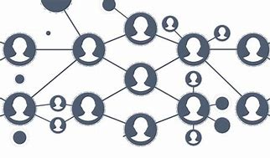
Time, Spaces, People, Places
The more time you spend and the closer in space you are to any infected people, the higher your risk. Interacting with more people raises your risk, and indoor places are riskier than outdoors.
William Miller, epidemiologist at Ohio State University

Slide 24
@mackayIM

Slide 25
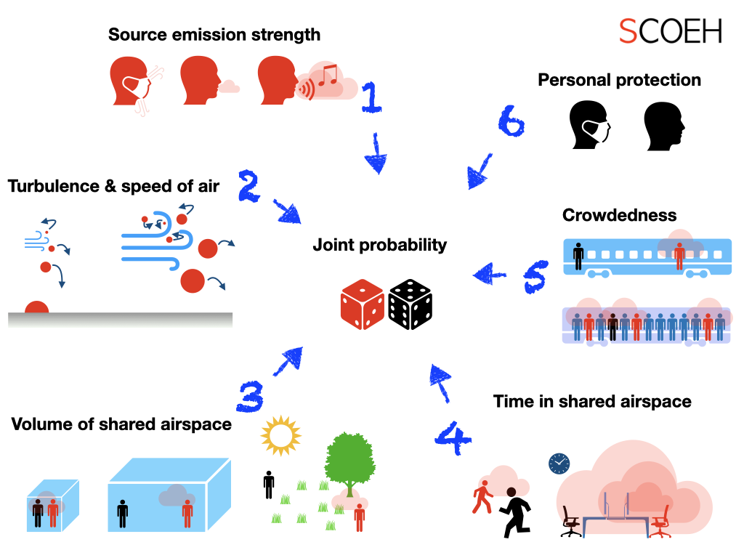
https://scoeh.ch/en/about/

