Slide 1
Relationships

Slide 2
Active Constructive Responding
A way of responding when someone shares good experiences or information
If the receiver of the good news actively and constructively responds, it can often provide a boost in wellbeing to both involved in the relationship

Slide 3
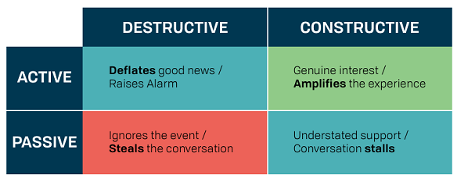
Active Constructive Responding

Slide 4
Active Constructive Responding
Active/Constructive
Displays enthusiasm, excitement, asks interested questions, reinforces positives and keeps the conversation going with eye contact
“That must feel fantastic”
“What happened next?”
“What is your plan?”
“I will make sure there is an announcement”

Slide 5
Active Constructive Responding
Active/Destructive
Talks about the negative, devils advocate, find a problem, frown and can look worried
“I cannot wait to see them argue over that!”
“I have no idea where we are going to find the resources for that!”
“I bet Tom will be upset”

Slide 6
Active Constructive Responding
Passive/Constructive
Smiles, acknowledge, reassure, silence and no expression
“That is great”
Passive/Destructive
Disinterest, diversion, avoidance, no expression, little eye contact, turning away
“Did you finish the activity”
“I had a call from..”

Slide 7
What are the benefits?
Personal Benefits
Increased positive emotions
Increased subjective well-being
Increased self-esteem
Decreased loneliness

Slide 8
What are the benefits?
Relationship Benefits
Increased relationship satisfaction
Increased commitment
Increased trust, liking, closeness
Increased stability

Slide 9
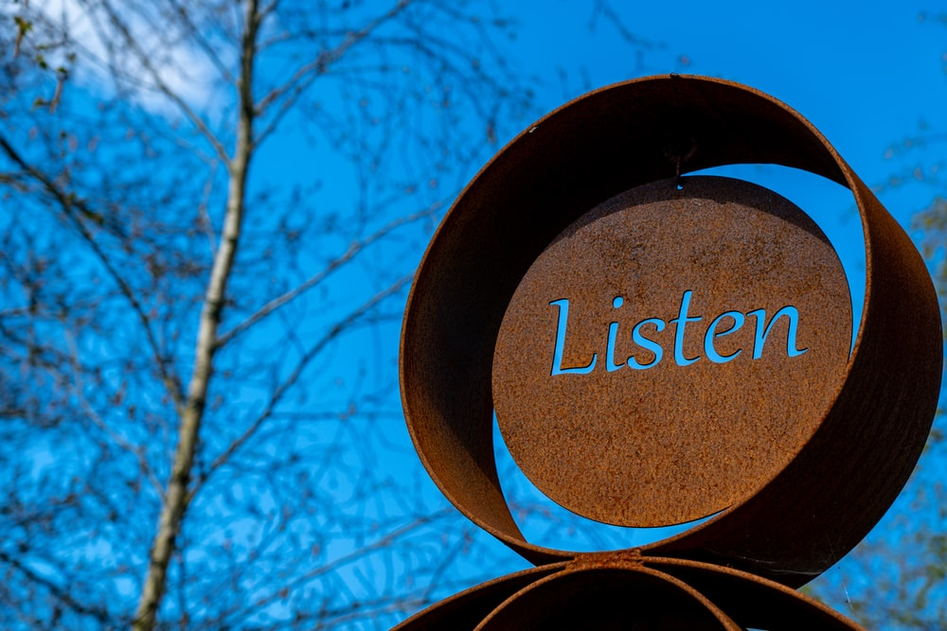
How can you respond better?
Listen activity and with empathy
Use positive body language
Don’t interrupt
Keep eye contact
Demonstrate your interest
Be upbeat in your response
Be positive
If you cannot be positive, be constructive
Don’t be dismissive or negative
Try to be constructive

Slide 10
THANK YOU

