Slide 1
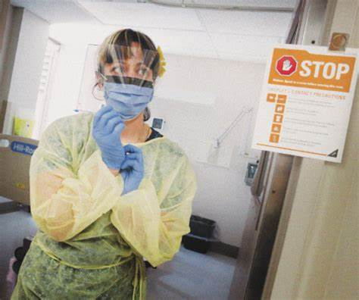
PPE Spotter Training

Slide 2
Welcome to PPE Spotter Training
Thank you for offering to be a PPE Spotter by being the ‘eyes’ for all our staff in high risk settings to keep them safe
All of the PPE resources referred to in this training can be found on the Western Health COVID-19 Microsite https://coronavirus.wh.org.au/ppe/
There is a dedicated section of the microsite for PPE Spotters and well as resources in the PPE Champion site https://coronavirus.wh.org.au/ppe/ppe-champions/

Slide 3
Context of the PPE Spotter role
Total 4169 cases
192
Total number of Western Health staff tested positive (27/10/2020)
Reference: Department of Health and Human Services https://www.dhhs.vic.gov.au/victorian-healthcare-worker-covid-19-data 29/11/2020

Slide 4
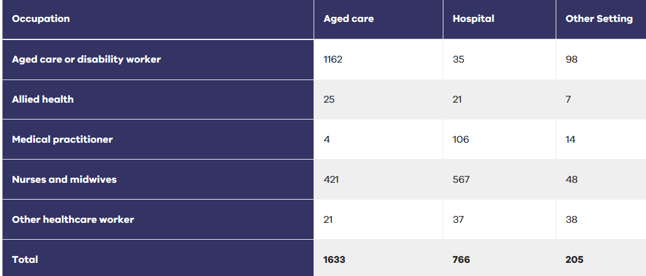
Breakdown by Setting - Clinical
74% RN/Midwives, 14% Doctors. 3% Allied Health & 4.8% Other HCWs
Reference: Department of Health and Human Services https://www.dhhs.vic.gov.au/victorian-healthcare-worker-covid-19-data 29/11/2020

Slide 5
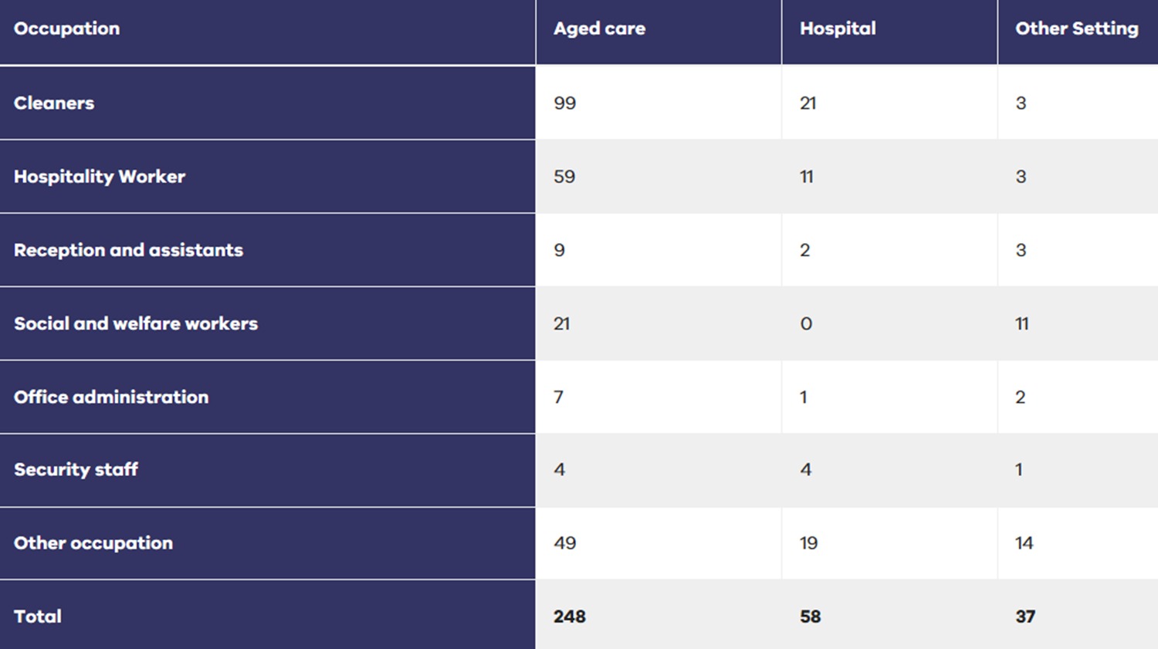
Breakdown by Setting – Non Clinical
Reference: Department of Health and Human Services https://www.dhhs.vic.gov.au/victorian-healthcare-worker-covid-19-data 29/11/2020

Slide 6
What is a PPE Spotter
Someone who is constantly observing to ensure all staff perform safe PPE practices with donning and doffing across all shifts
Is supernumerary to ensure any PPE infectious risks are minimised to staff without distractions
Acts as a role model for safe PPE practices
Supervises safe donning and doffing
Provides ‘just in time’ training
Provides support for skin and pressure injuries from PPE

Slide 7
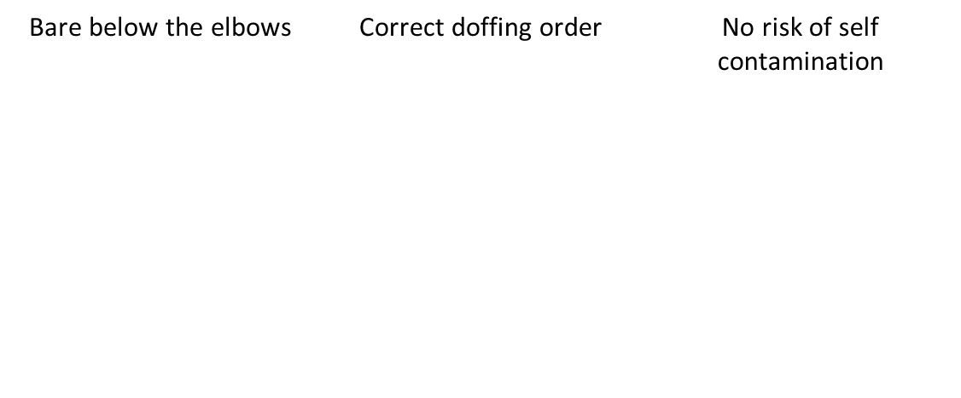
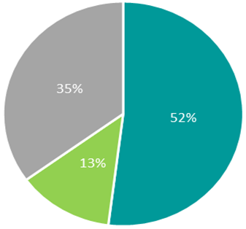
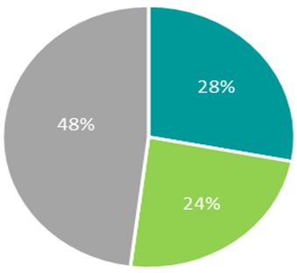
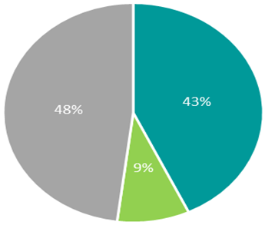
PPE Champion Audit data
Correct PPE items worn | Correct donning order | Correct fit check steps | Correct disposal of PPE
Goal achieved
Trend toward improvement
Fluctuation Source final PPE Champion Audit data 23rd October 2020

Slide 8
German PPE Study
Antimicrobial Resistance and Infection Control (Dec 2020) https://doi.org/10.1186/s13756-020-00864-w

Slide 9
Adherence to PPE by HCWs in COVID and non-COVID areas

Slide 10
Adherence to PPE by HCWs in COVID and non-COVID areas
Source: Neuwirth et al. Antimicrob Resist Infect Control (2020) 9:199 https://doi.org/10.1186/s13756-020-00864-w

Slide 11
Why Spotters?
Additional support to staff in high risk areas
Removes the human error factor
Prevents mishaps due to fatigue, dehydration, anxieties and normal day to day business
2nd pair of eyes
Supernumerary
Roaming
Identifying risks in real time and checks practice

Slide 12
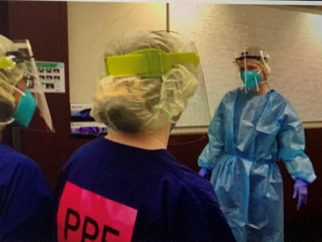
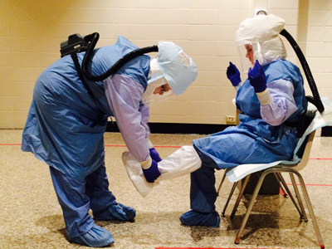
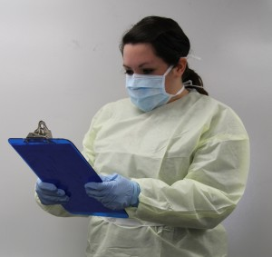
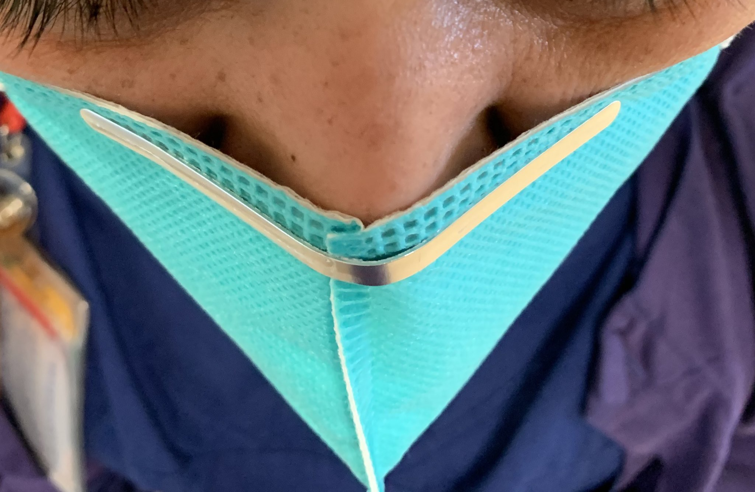
Spotters and Buddies
Spotters
Buddies

Slide 13
How to be an effective Spotter
By being vigilant in spotting defects in PPE equipment
By being proactive in identifying upcoming risks to staff
Follows the provided PPE checklist, but focuses on the big picture of the clinical environment
Staff entering the ward
Where staff congregate at Nurses Station
Where physical distancing is not easily maintained
Break rooms and offices
Is informative, supportive and well-paced in issuing instructions or advice on PPE to all attending staff
Always practices hand hygiene immediately after providing assistance
Supported by having organisational authority and empowerment to to ‘speak up’ and call out unsafe PPE practices that is not in accordance with WH infection prevention best practice and PPE guidelines

Slide 14
PPE Spotter Sticker

Slide 15
Route of Transmission
Route of transmission is likely to be droplet spread through close contact with infected individuals
R0 2.5-3, similar to (1918 Pandemic was 2.8), compare with Chickenpox (3.7-5) and Measles (12-18)

Slide 16
Infectious Chain of Transmission
Demonstrating transmission
Secret life of a sneeze video
Lighting up the virus – mask cross contamination video

Slide 17
PPE Up Skilling
Selecting the right Personal Protective Equipment each time
Western Health COVID-19 PPE Guideline
PPE Tiers Posters
Safely donning, doffing and fit checking PPE in the right order each and every time resources
https://coronavirus.wh.org.au/ppe/
Donning and doffing poster
Surgical Mask poster
P2/N95 respirator mask posters
P2/N95 respirator mask training videos
Facial Hairstyles and P2/N95 poster
P2/N95 Mask Fit-checking Escalation Process for Staff QRG
*Microsite (PPE Video’s & Training Guides) – Standard Precautions video and Fit checking video

Slide 18
Facial Pressure Injuries
P2/N95 Respirator Masks
Protective dressings are NOT to be used on the face under P2/N95 respirator masks as they may impair the seal and not provide protection
Aim is to prevent pressure injuries early so they don’t occur
Facial pressure injuries and skin issues from PPE QRG

Slide 19
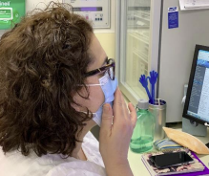
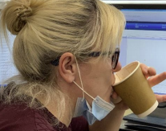
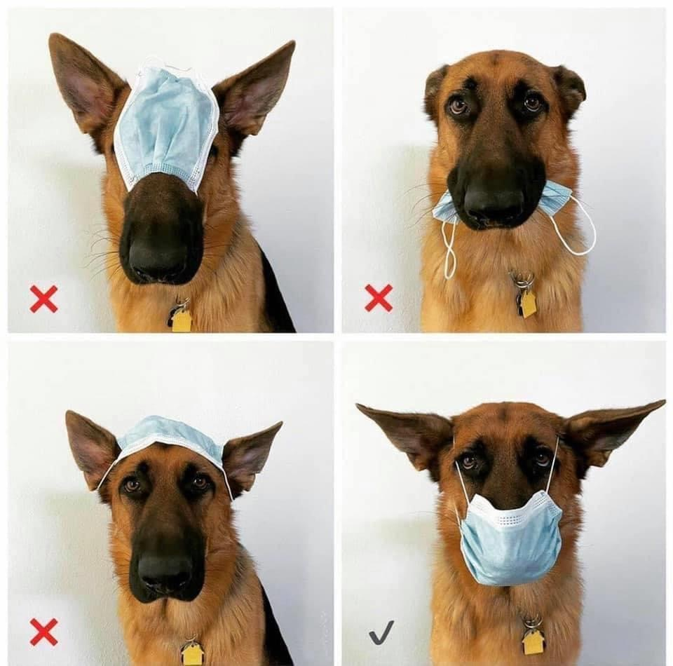
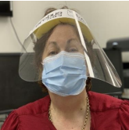
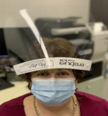
Maintaining Good PPE Practices
Everyday things we need to do differently in a COVID-19 world QRG

Slide 20
Challenges
Perceptions that Spotters are the PPE Police
Staff not receptive, dismissive or avoidance
Low perceptions of risks with small case numbers
Complacency
Reverting to old practices pre-COVID
Changing PPE (new P2/N95 masks) and guidelines – staff frustrations, confusions

Slide 21
Opportunities
I’m here to help keep you safe
Supporting a safety first culture
PPE donned and doffed correctly
Staff reassurance and confidence in PPE
Establishing rapport with feedback – part of the team
Positive role modelling
Donning and doffing PPE with ‘just in time’ training and coaching are sets of behaviours
Encouraging appropriate safe PPE practice = supportive behaviour change = protection

Slide 22
PPE Spotter Role Description and Responsibilities
Shift Responsibilities
Report to NUM or Nurse in Charge at the beginning of shift for allocated area
After hours report to the site AHA initially if not from that ward
Introduce yourself to each clinical team member and visiting staff
Ensure staff entering the ward are in the appropriate Tier PPE for that area
That all staff are Bare Below the Elbow to facilitate hand effective hygiene
Ensure the safety of each team member by spotting (observing) the donning and doffing process of all staff in the area plus observing mask practices in staff areas
Ensure correct OH&S and infection prevention procedure and ‘Speak Up’ for safety
Ensure that the appropriate patient room posters for transmission based precautions are in place to assist staff
Conduct one-on-one in situ PPE coaching/training when needed from observations

Slide 23
PPE Spotter Responsibilities Con’t
Encourage a ‘no haste’ approach for staff when they are donning and doffing especially in MET or emergency response situations
Be the go-to person for appropriate usage of PPE in line with the Tier PPE designation for that area
Be the PPE resource to ensure PPE stock is readily available
Ensure any equipment that comes out of a room or bay is cleaned i.e. vital signs machines and thermometers
Ensure staff clean appropriately their face shields or goggles, stethoscopes, mobile phones, devices, WOWs etc as required
Wear the provided PPE Spotter sticker to clearly be identified by all staff
Provide a shift summary of key issues identified via email WHPPESpotters@wh.org.au

Slide 24
Contacts:
Infection Prevention
Maureen Canning
Maureen.Canning@wh.org.au
PPE Spotter email WHPPESpotters@wh.org.au
WH Infection Prevention
WHSinfectioncontrol@mh.org.au
If watching this as a recording please email maureen.canning@wh.org.au with the following for registration purposes:
* full name
* Employee Number
* Area worked (Pool/Bank, ward or other)
* Role (if non nursing)
* If an existing PPE Champion upskilling

